Slide 1
Spreadsheets and Business Graphics

Slide 2
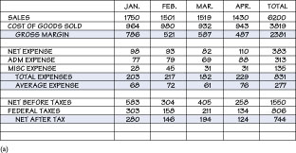
The Nature of Spreadsheets
Spreadsheets organize data in rows and columns
  Creating spreadsheets manually is tedious
  Manual spreadsheets are prone to error
  Manual spreadsheets have to be recalculated by hand if data changes

Slide 3
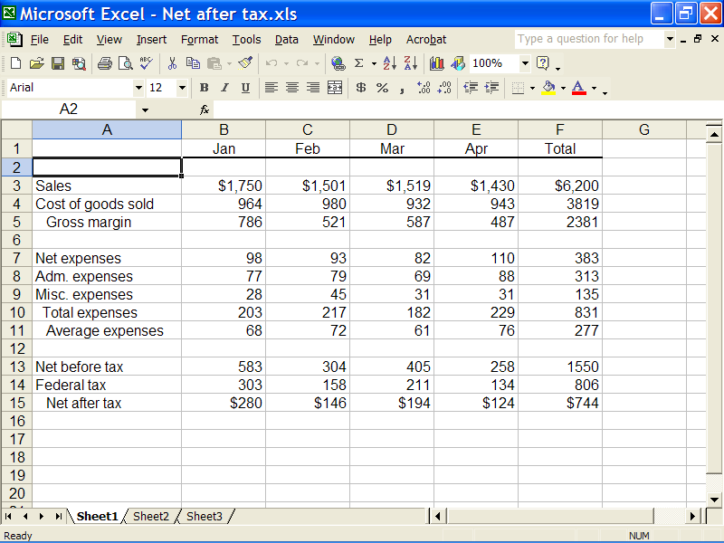
Electronic Spreadsheets
A computerized version of a paper spreadsheet
Benefits
  Eliminates much of the tedium
  Calculations are error-free
  Worksheet is automatically recalculated when you change one value or calculation
  Performs “what-if” analysis

Slide 4
What-If Analysis
Allows users to change one value and have the results instantly recalculated
  Very useful in financial forecasting
Return

Slide 5
Spreadsheet Fundamentals
Cells and cell addresses
Contents of cells
Ranges

Slide 6
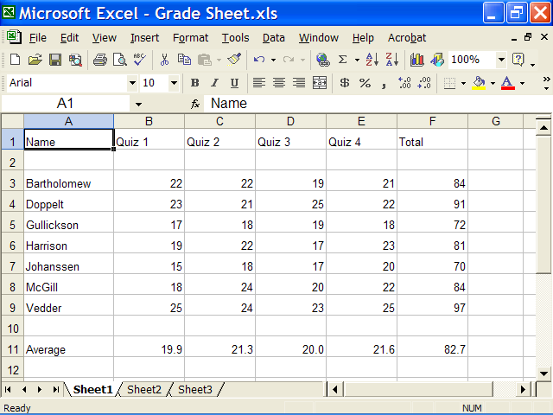
Cells and Cell Addresses
Spreadsheet is divided into rows and columns
A cell is the intersection of a row and a column
  Cell is known by its address
    Address consists of column letter, followed by row number, for example B7
  Active cell - the cell available to be edited at a given time
Return

Slide 7
Contents of Cells
Label – provides descriptive text information about entries in the spreadsheet
Value – an actual number that is entered into a cell
Displayed value – what is displayed in the cell
  Formula – an instruction to the program to calculate a number
  Function – a preprogrammed formula
Return

Slide 8
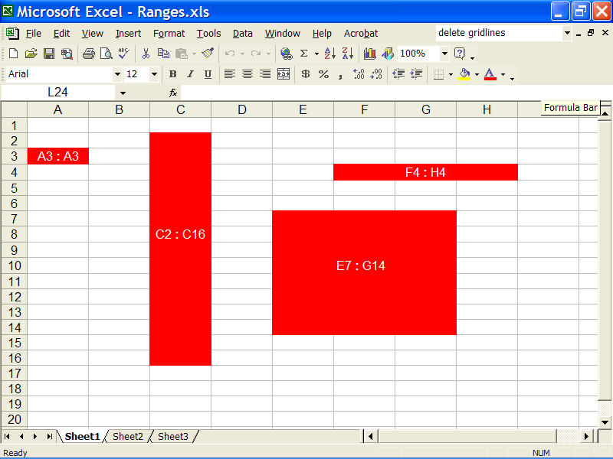
Ranges
A group of one or more adjacent cells occurring in a rectangular shape
  The program treats the range as a unit
  A range is referred to by its upper-left and lower-right cells, for example E7:G14
Return

Slide 9
Spreadsheet Features
Width of columns and height of rows can be modified
Headings can be created as a wide column
Numbers can be formatted with the appropriate symbols such as a percent sign
  The number of decimal places can be specified
There are a full range of printing options
  Margins can be changed
  Worksheets can be printed in portrait or landscape orientation

Slide 10
Spreadsheet Features
Security
  Cells can be protected so the user doesn’t accidentally destroy complex formulas
  Password protection can prevent anyone from making changes to the worksheet
Decoration
  Add borders or colors to cells or ranges
  Change the color of fonts
  Add clip art

Slide 11
A Problem For a Spreadsheet
Planning the spreadsheet
Making a first draft
Changing the spreadsheet
Formatting and printing
Creating a graph from spreadsheet data

Slide 12
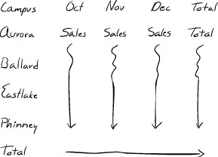
Planning the Spreadsheet
Create a sketch of the spreadsheet
  Show how labels and data should appear
  Specify any formulas and/or functions needed
Return

Slide 13
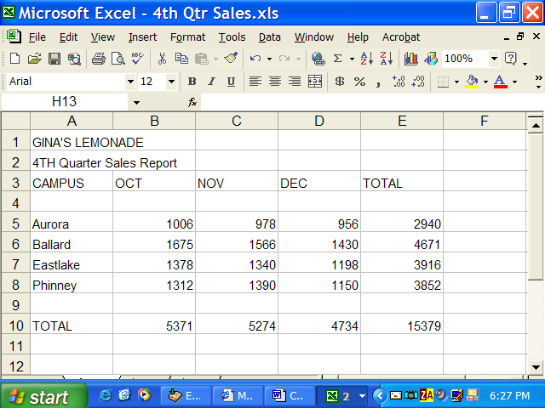
Making a First Draft
Type the column and row headings
Enter data into cells
Enter and test formulas
Return

Slide 14
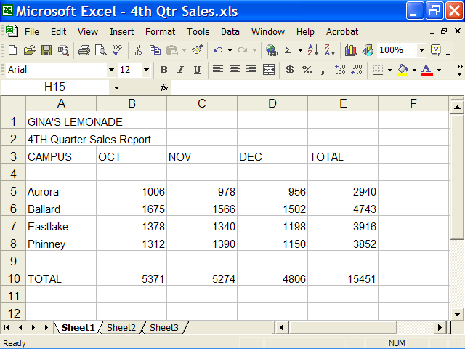
Changing the Spreadsheet
Change the value in cell D6
  Cell E6, which calculates the total of row 6, is recalculated
  Cell D10, which calculates the total of column D, is recalculated
  Cell E10, which calculates the grand total, is recalculated
Return

Slide 15
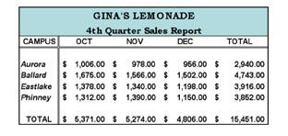
Formatting and Printing
Format labels
Format sales numbers as currency
Add borders to separate areas of the table
Use cell shading on the main headings
Return

Slide 16
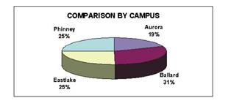
Creating a Graph
Graph is created based on the data in the spreadsheet
  Pie chart is used to make comparisons among campuses
Return

Slide 17
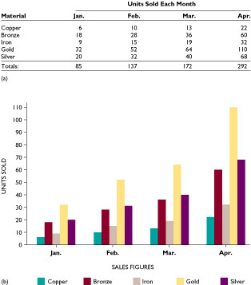
Business Graphics
Graphics that represent data in a visual, easily understood format
  Generate and sustain interest
  Graphs easily reveal trends that could be lost if buried in long columns of numbers
Two types:
  Analytical graphics
  Presentation graphics

Slide 18


Analytical Graphics
Designed to help users analyze and understand specific data
Produce simple line, bar, and pie chart graphs
Offer relatively few formatting options
Return

Slide 19
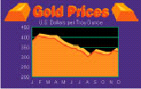

Presentation Graphics
Let you produce charts, graphs, and other visual aids
  Charts look as if they were prepared by professional graphic artist
Offer much more clarity and appeal than analytical graphics
Return

Slide 20
Presentation Graphics Programs
Allow you to do several tasks
  Edit and enhance charts created by other programs
  Create slides from scratch
    Slides can contain charts, diagrams, drawings, or text
  Use clip art that comes with the graphics program
  Create an animated presentation
  Use small files to add sound to your presentation

Slide 21
Common Types of Graphs
Line graphs
Bar graphs
Pie charts
Parts of a graph

Slide 22
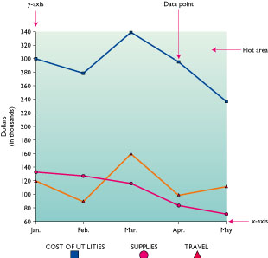
Line Graphs
Illustrate multiple comparisons
Data is plotted in plot area, then connected by a line
Return

Slide 23
Bar Graphs
Used to illustrate multiple comparisons
Data is plotted in plot area, then a rectangular bar is filled in from the x-axis to the data point
Comparisons are easy to absorb
Return

Slide 24
Pie Charts
Show how each data point contributes to the total
  The whole amount is represented as a circle
  Each data point is represented as a slice of the circle
Exploded pie chart shows one or more wedges pulled slightly away from the pie
Return

Slide 25
Parts Of a Graph
Horizontal axis (x-axis) – represent units in time or characteristics
Vertical axis (y-axis) – represent values or amounts
Plot area – the area where data is plotted
Data point – each dot or symbol on a line graph
Labels – identify the axes
Titles – summarize the information in a graph
Return

